Slide 1
WELCOME
SPARSE MATRIX MULTIPLICATION
DESIGNED AND PRESENTED BY :
KUMAR SHIVAM RANJAN
NAMAN GARG
KUNDAN KUMAR
KSHITIJ SHARMA
MADHUR SAHU

Slide 2



CONTENTS
What is Sparse Matrix?
How to Store it?
Operations
Fast Multiplication Algorithm
Critical Assessment

Slide 3

WHAT IS SPARSE MATRIX?

Slide 4
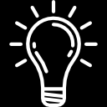
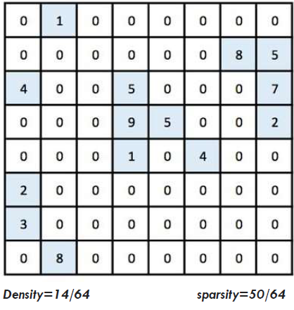
A sparse matrix or sparse array is a matrix in which most
of the elements are zero. Large sparse matrices often
appear in scientific or engineering applications when
solving partial differential equations.
If most of the elements are nonzero, then the matrix is considered dense. The number of zero-valued elements divided by the total number of elements (e.g., m × n for an m × n matrix) is called the sparsity of the matrix (which is equal to 1 minus the density of the matrix). Using those definitions, a matrix will be sparse when its sparsity is greater than 0.5.

Slide 5
HOW TO STORE IT ?

Slide 6
Representing a sparse matrix by a 2D array leads to wastage of lots of memory as zeroes in the matrix are of no use in most of the cases. So, instead of storing zeroes with non-zero elements, we only store non-zero elements. This means storing non-zero elements with triples- (Row, Column, value). Sparse Matrix Representations can be done in many ways following are two common representations:
1. Array representation
2. Linked list representation

Slide 7
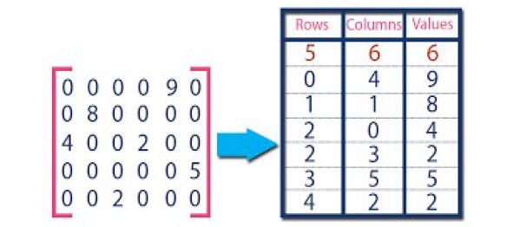
USING ARRAYS
2D array is used to represent a sparse matrix in which there are
three rows named as
• Row: Index of row, where non-zero element is located
• Column: Index of column, where non-zero element is located
• Value: Value of the non-zero element located at index – (row, column)

Slide 8
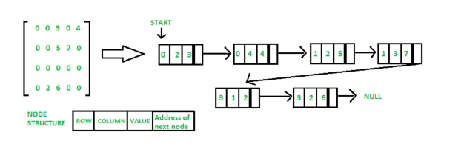
USING LINKED LIST
In linked list, each node has four fields. These four fields are
defined as:
• Row: Index of row, where non-zero element is located
• Column: Index of column, where non-zero element is located
• Value: Value of the non-zero element located at index – (row, column)
• Next node: Address of the next node

Slide 9
OPERATIONS

Slide 10
ADD TWO GIVEN MATRICES
To Add the matrices, we simply traverse through both
matrices element by element and insert the smaller element
(one with smaller row and col value) into the resultant matrix.
If we come across an element with the same row and column
value, we simply add their values and insert the added data
into the resultant matrix.

Slide 11
TRANSPOSE A GIVEN MATRICES
To Transpose a matrix, we can simply change every column
value to the row value and vice-versa, however, in this case,
the resultant matrix won’t be sorted as we require. Hence,
we initially determine the number of elements less than the
current element’s column being inserted in order to get the
exact index of the resultant matrix where the current element
should be placed. This is done by maintaining an array index
[] whose ith value indicates the number of elements in the
matrix less than the column i.

Slide 12
MULTIPLY TWO GIVEN MATRICES
To Multiply the matrices, we first calculate transpose of the
second matrix to simplify our comparisons and maintain the
sorted order. So, the resultant matrix is obtained by
traversing through the entire length of both matrices and
summing the appropriate multiplied values. Any row value
equal to x in the first matrix and row value equal to y in the
second matrix (transposed one) will contribute towards
result[x][y]. This is obtained by multiplying all such elements
having col value in both matrices and adding only those with
the row as x in first matrix and row as y in the second
transposed matrix to get the result[x][y].

Slide 13
FAST MULTIPLICATION ALGORITHM

Slide 14
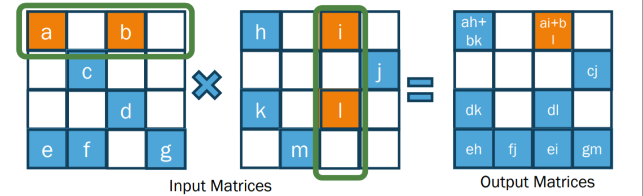
Sparse General Matrix-Matrix Multiplication (SpGEMM)
Key kernel in graph processing and numerical applications:
Markov clustering, Betweenness centrality, triangle counting, ...
Preconditioner for linear solver
AMG (Algebraic Multigrid) method
Time-consuming part

Slide 15
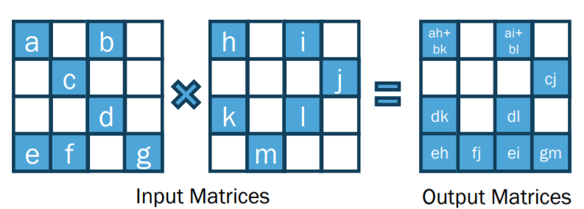
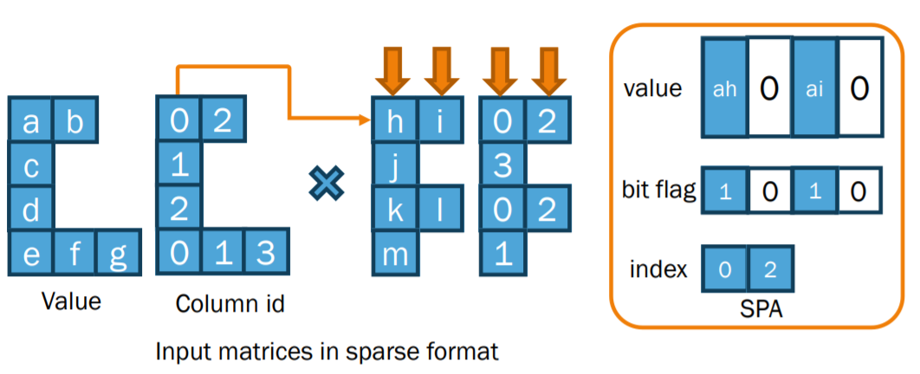
Accumulation of intermediate products

Slide 16
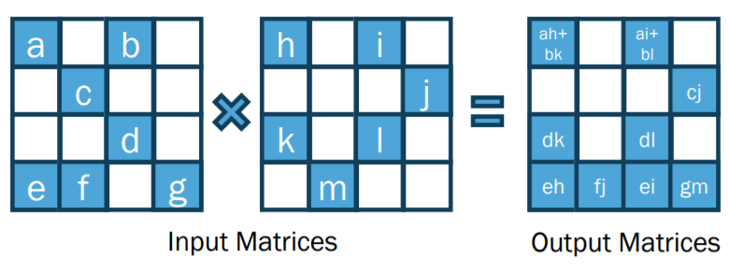
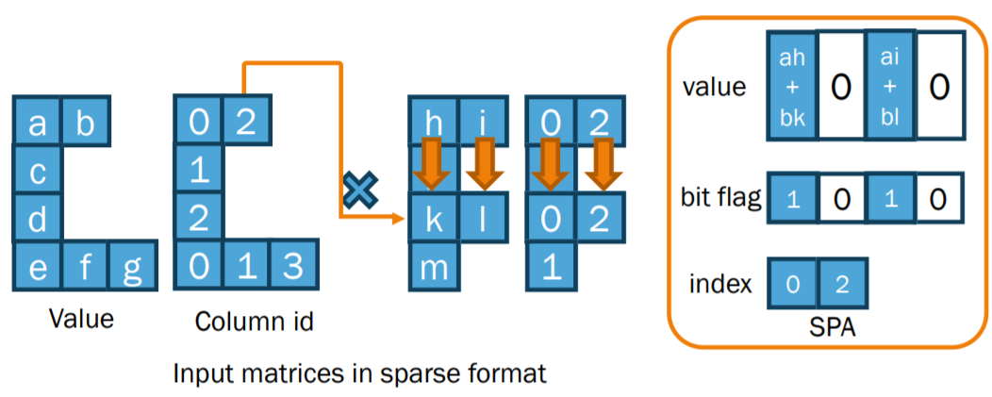
Accumulation of intermediate products

Slide 17
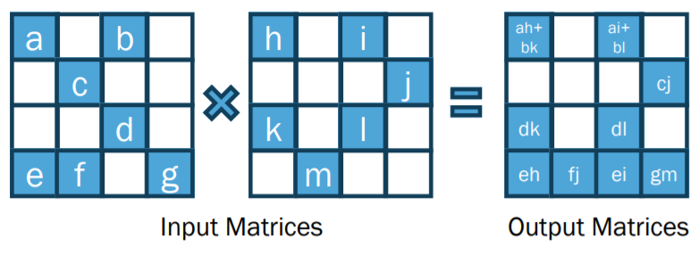
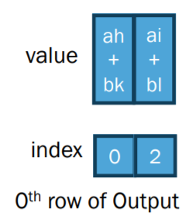
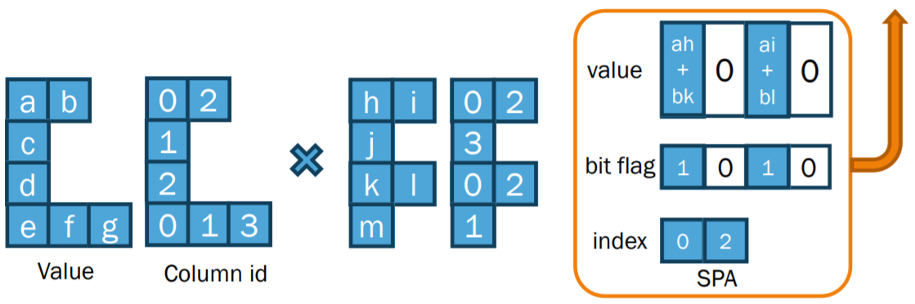
Accumulation of intermediate products

Slide 18
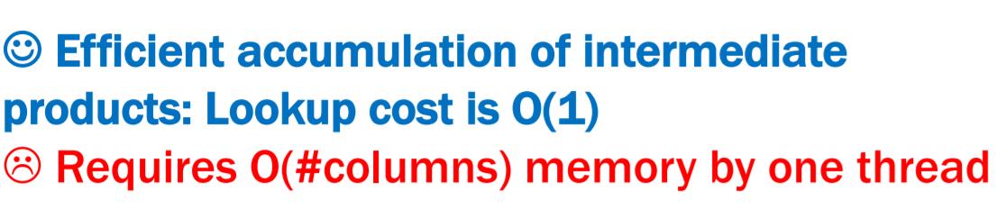
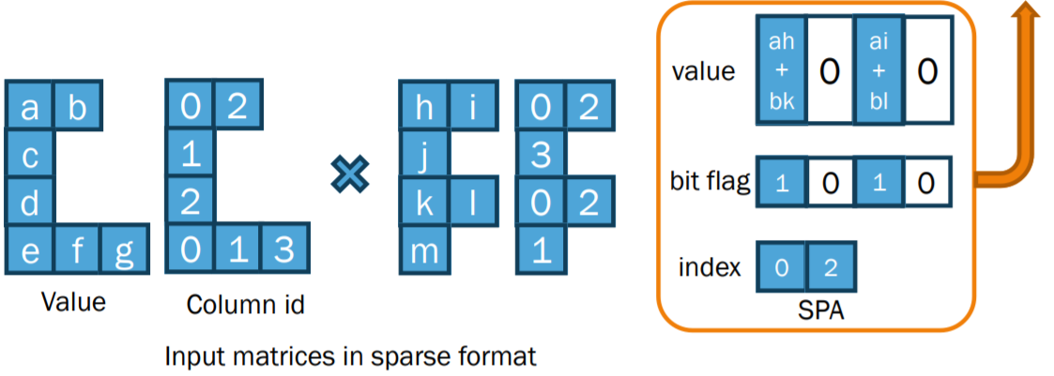
Accumulation of intermediate products

Slide 19
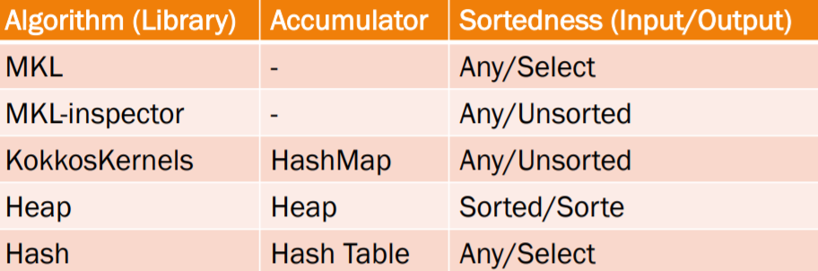
Existing approaches for SpGEMM
Several sequential and parallel SpGEMM algorithms
– Also packaged in software/libraries

Slide 20
ALGORITHM 1 – Gustavson’s Row-wise SpGEMM 3
Input: Sparse matrices A and B
Output: Sparse matrix C
set matrix C to
for all ai* in matrix A in parallel do
for all aik in row ai* do
for all bkj in row bk* do
value ← aik bkj
If cij Ɇ ci* then
insert ( cij ← value ) to ci*
else
cij ← cij + value
end if
end for
end for
end for

Slide 21
ALGORITHM 2 – Rows to Threads
Input: Sparse matrices A and B
Output: Array offset
1. Set FLOP vector
for i ← 0 to m in parallel do
flop [ i ] ← 0
for j ← rptsA [ i ] to rptsA [ i+1] do
rnz ← rptsB [ cols A [ j] + 1] – rptB [colsA [ j]]
flop [ i ] ← flop [ i ] + rnz
end for
end for
2 . Assign rows to thread
Flopps ← ParallelPrefixSum ( flop )
Sumflop ← flopps [ m ]
tnum ← omp_get_max_threads ()
aveflop ← sumflop / tnum
offset[0] ← 0
for tid ← 1 to tnum in parallel do
offset [ tid ] ← lowbnd ( flopps, aveflop tid )
end for
offset [ tnum ] ← m

Slide 22
ALGORITHM 3 – HASH SpGEMM
Input: Sparse matrices A and B
Output: Sparse matrix C
offset ← RowsToThreads ( A, B )
{Determine hash-table size for each thread}
tnum ← omp_get_max_threads ()
for tid ← 0 to tnum in parallel do
sizet ← 0
for i ← offset [ tid] to offset [ tid + 1] do
sizet ← max ( sizet , flop [ i ] )
end for
{Required maximum hash-table size is Ncol }
sizet ← min ( Ncol , sizet )
{Return minimum 2n so that 2n > sizet }
sizet ← lowest_p2 ( sizet )
end for
Symbolic ( rptsC , A, B )
Numeric ( C, A, B

Slide 23
CRITICAL ASSESSMENT

Slide 24
CRITICAL ASSESSMENT
SpGEMM computation has two critical issues unlike dense matrix multiplication. Firstly, the pattern and the number of non-zero elements of output matrix are not known beforehand. For this reason, the memory allocation of output matrix
becomes hard, and we need to select from two strategies. One is a two-phase method, which counts the number of non-zero elements of output matrix first (symbolic phase), and then allocates memory and computes output matrix (numeric phase). The other is a one-phase method, where we allocate large
enough memory space for output matrix and compute. The former requires more computation cost, and the latter uses much more memory space. Second issue is about combining the intermediate products to non-zero elements of output matrix. Since the output matrix is also sparse, it is hard to efficiently
accumulate intermediate products into non-zero elements. This procedure is a performance bottleneck of SpGEMM computation, and it is important to devise and select better accumulator for SpGEMM.

Slide 25
**THANK YOU**

